Slide 1

Module 7
Neural Networks
Notes:
Guidelines
Use section headers to chunk content in your presentation.
Use the same style of section header throughout your presentation.
Keep your title to no more than 2 lines.

Slide 2
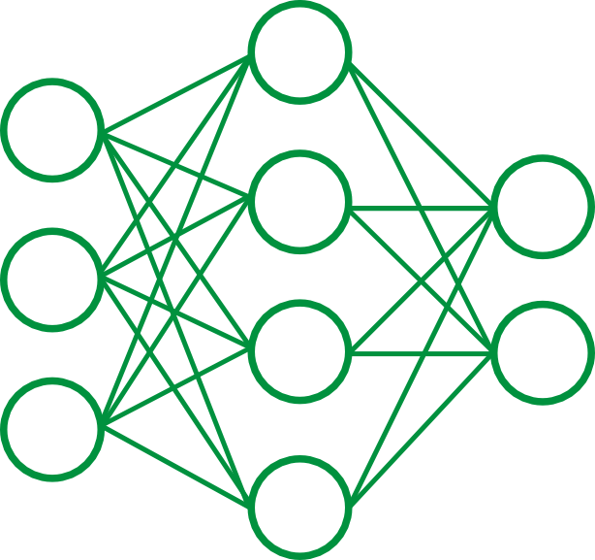
Neural Networks
Notes:
Guidelines
Use a title slide at the beginning of your presentation. There are 9 variations of title slides to choose from.
If you will have a series of slideshows, we recommend using the same style of title slide for each presentation.
Keep your title to no more than 2 lines.
Do not change the font style or font size of the title or subtitle.

Slide 3
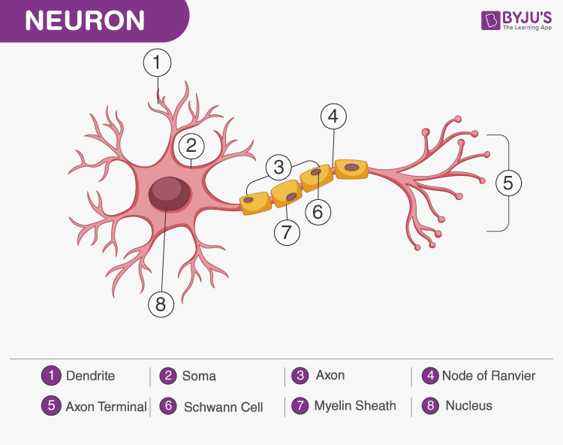
Neural Networks
Very flexible family of models
The basis of deep learning
Are inspired by biological neurons.

Slide 4
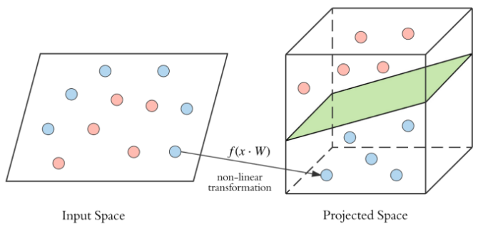
NNs Learn Non-Linear Surfaces
Very helpful when data is linearly non-separable
Can project data into a higher dimension

Slide 5
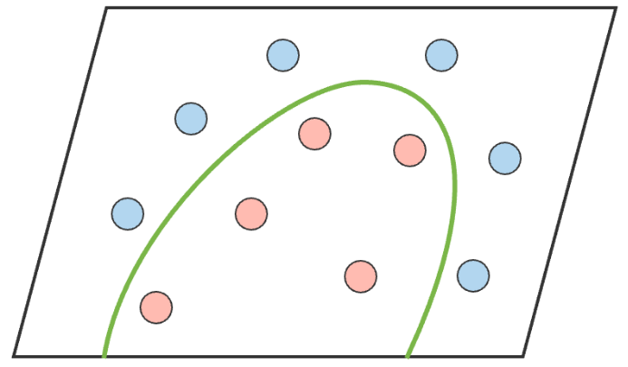
NNs Learn Non-Linear Surfaces
Very helpful when data is linearly non-separable
Can project data into a higher dimension

Slide 6
Types of Neural Networks
Notes:
Guidelines
Use a title slide at the beginning of your presentation. There are 9 variations of title slides to choose from.
If you will have a series of slideshows, we recommend using the same style of title slide for each presentation.
Keep your title to no more than 2 lines.
Do not change the font style or font size of the title or subtitle.

Slide 7
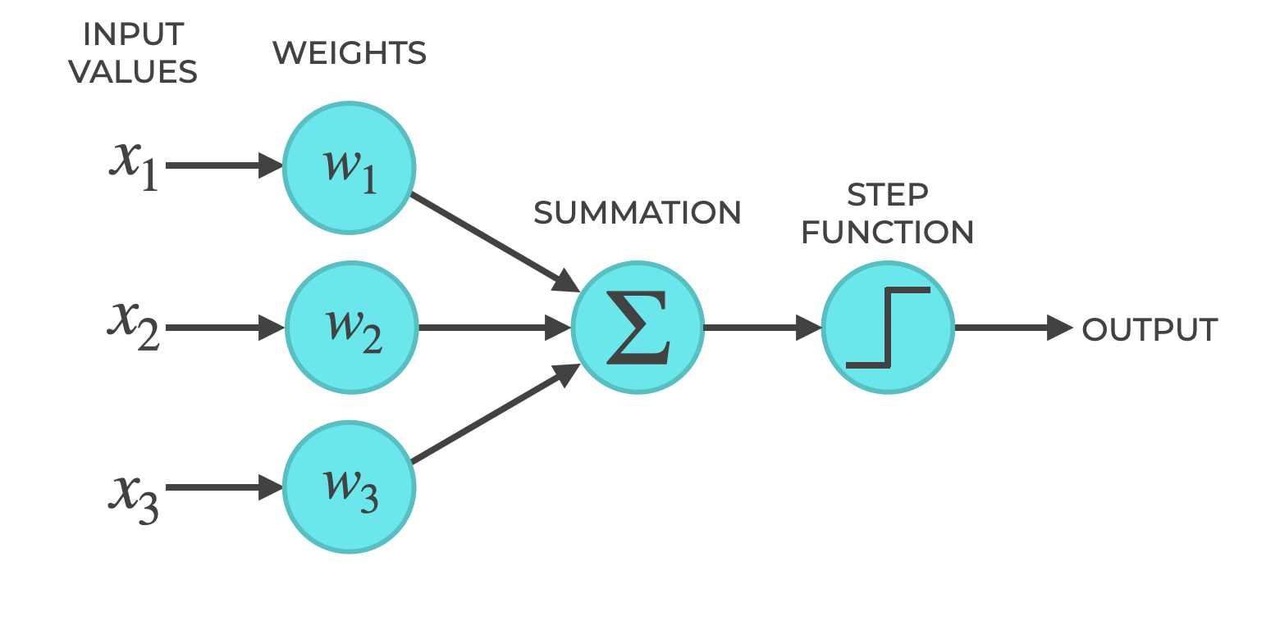
Perceptrons
Simplest NN architecture
Forms the foundation of modern neural networks.
Fast and efficient for linearly separable data.

Slide 8
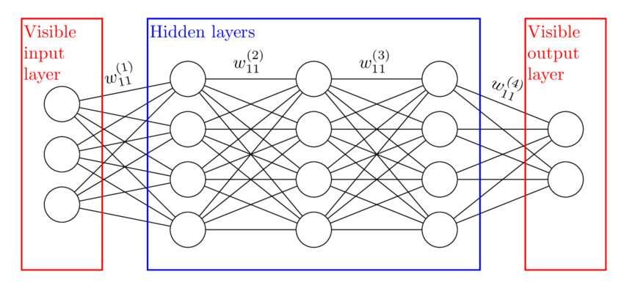
Multi-Layer Perceptron
Type of architecture (fully connected neurons) that is composed of:
An input layer: represents the values of the original variables
An output layer: predictions for the response variable
Hidden layers: any layer between the input and the output layers

Slide 9
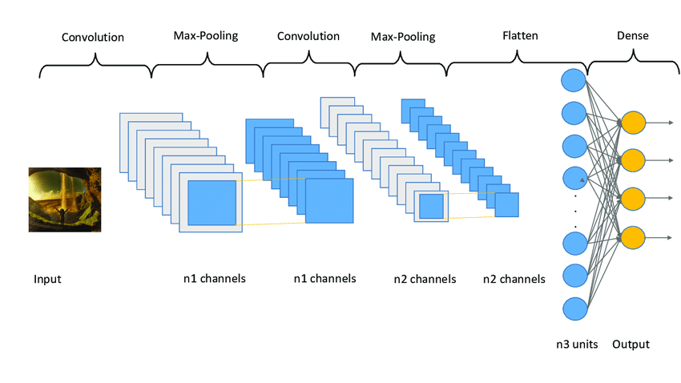
Convolutional Neural Networks
Type of architecture that is composed of:
Input layer: represents generally pixels of the original variables
Convolutional layers: meant to better obtain characteristics of pictures
Pooling layers: used to reduce dimensions and combine pixels
Dense Layers: Fully connected neurons with hidden layers

Slide 10

Recurrent Neural Networks
Used to better understand sequential data

Slide 11
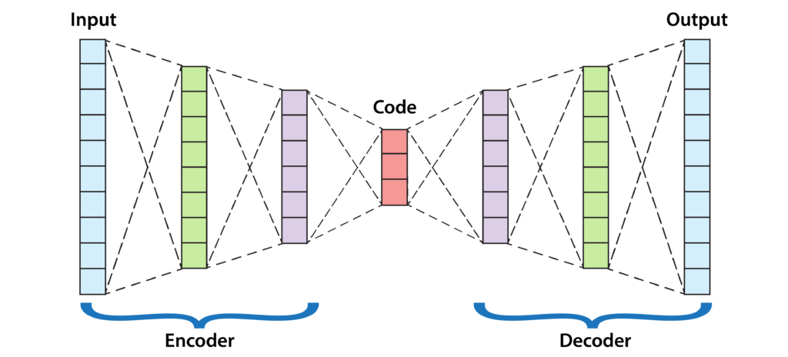
AutoEncoder Neural Networks
Reconstructs data. Used as generative model.

Slide 12
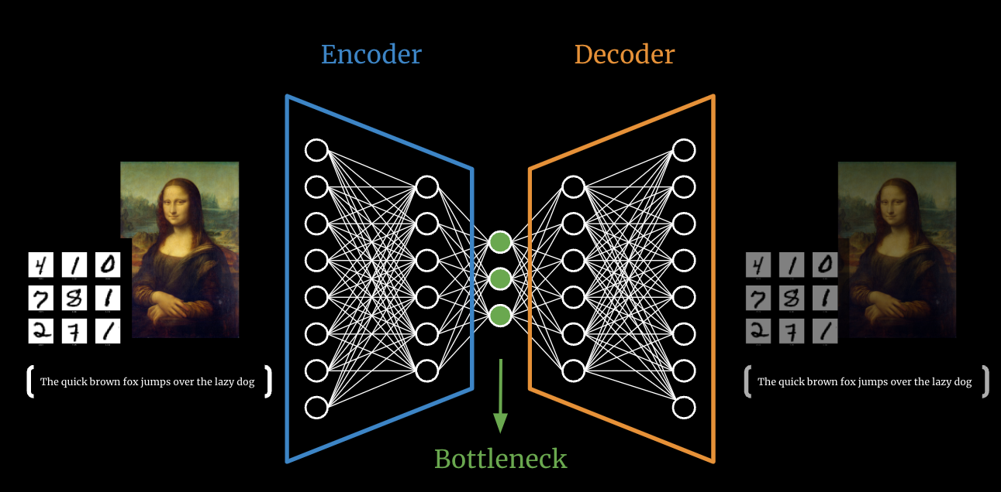
AutoEncoder Neural Networks
Reconstructs data. Used as generative model.

Slide 13
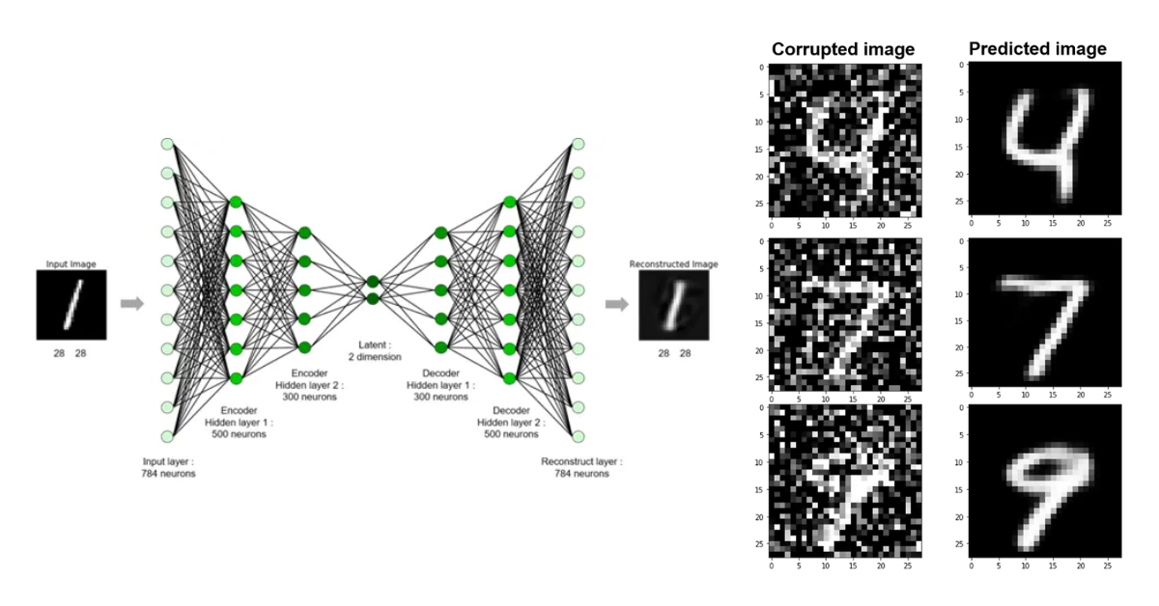
AutoEncoder Neural Networks
Reconstructs data. Used as generative model.

Slide 14

Generative Adversarial Networks
Reconstructs data. Used as generative model.

Slide 15
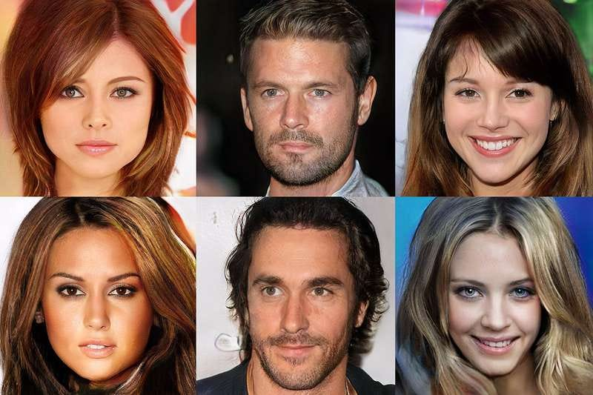
Generative Adversarial Networks
Reconstructs data. Used as generative model.

Slide 16
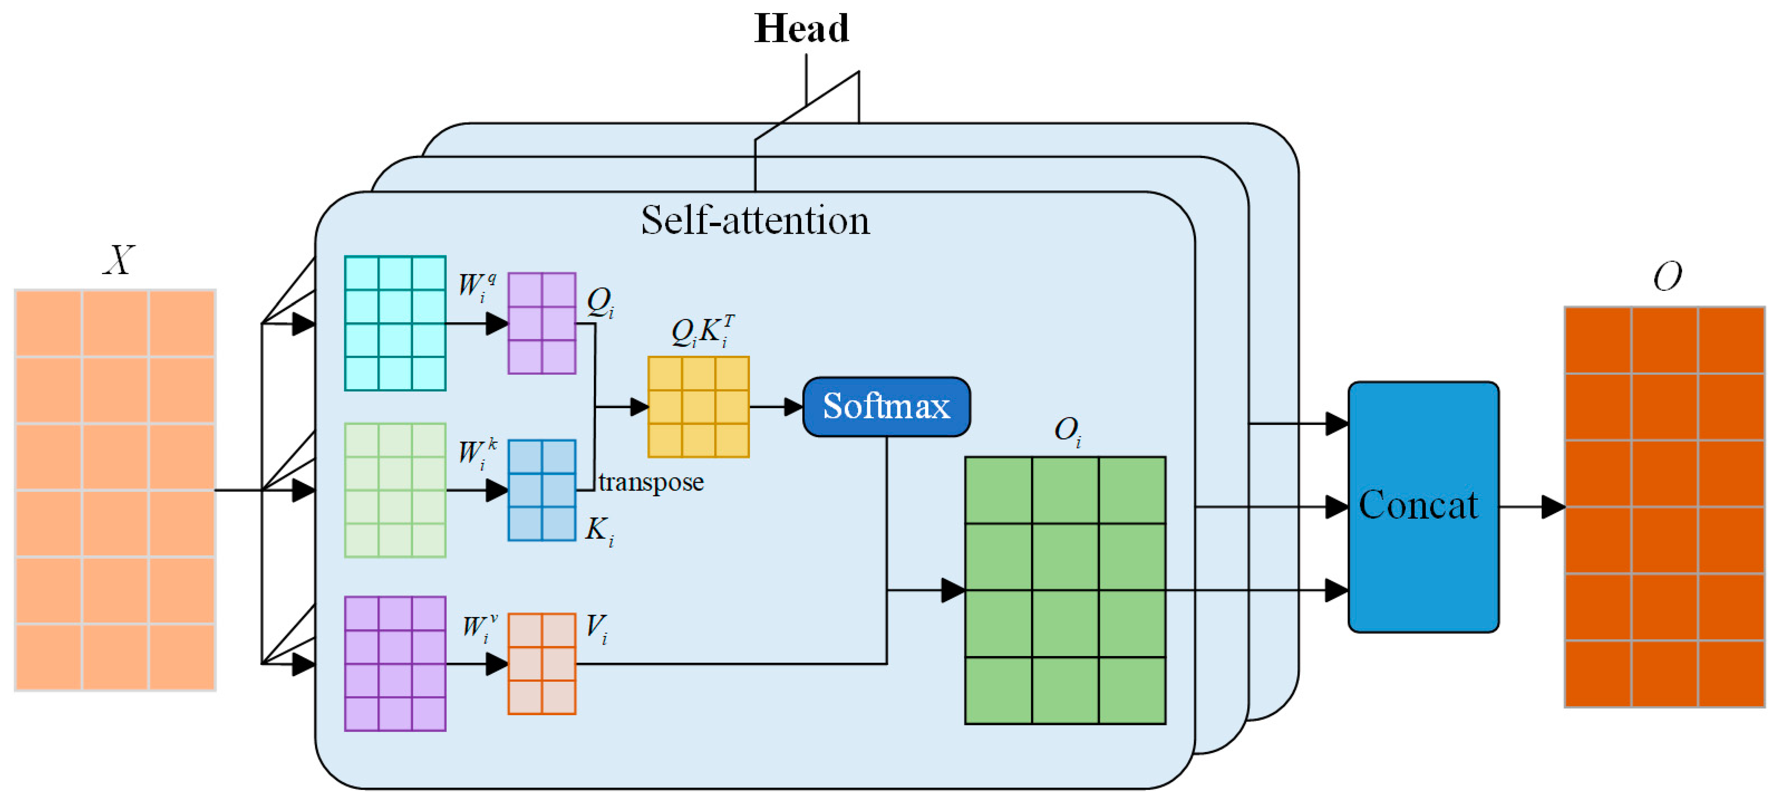
Multi-Attention NNs
Parallel attention mechanisms
Designed to focus on diverse aspects of input data
Captures varied dependencies or relationships within data

Slide 17
Multi-Layer Perceptrons (MLPs)
Notes:
Guidelines
Use a title slide at the beginning of your presentation. There are 9 variations of title slides to choose from.
If you will have a series of slideshows, we recommend using the same style of title slide for each presentation.
Keep your title to no more than 2 lines.
Do not change the font style or font size of the title or subtitle.

Slide 18
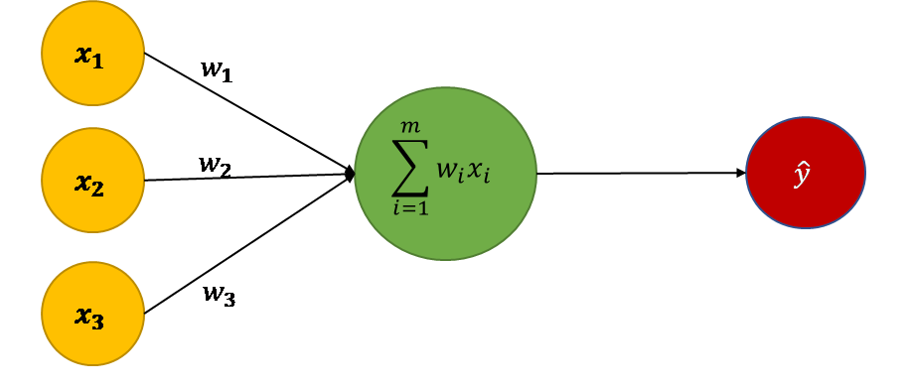
Neurons
Fundamental building block of NNs
Inspired by a biological neuron
Composed by a summation function and an activation function

Slide 19
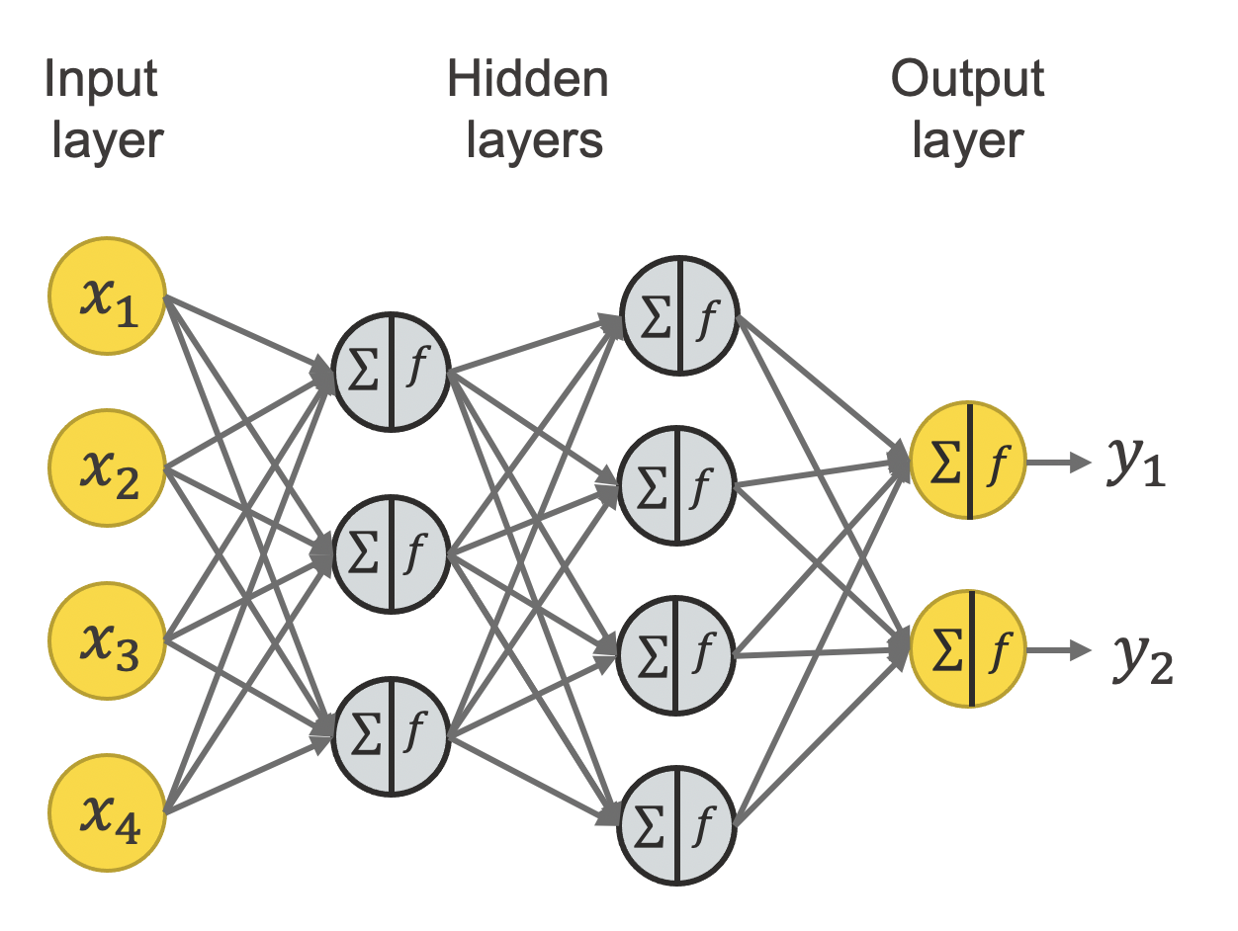
The Input Layer
Units (neurons) are the predictors (variables)

Slide 20
The Output Layer (# of Neurons)
Regression: 1 is needed for the output layer.
Binary Classification: 1 (dummy-encoding), 2 (one-hot encoding)
Multi-Class: # of classes

Slide 21
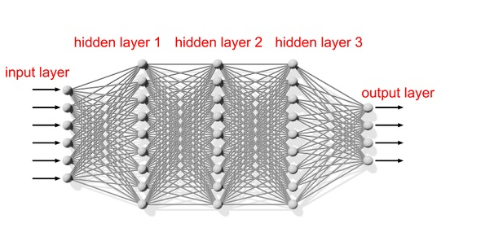
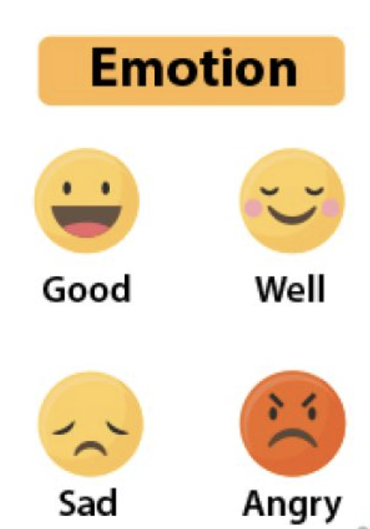
The Output Layer (# of Neurons)
Example

Slide 22
Hidden Layers (# of Neurons)
Number of layers and neurons are hyperparameters
More neurons can learn more complex data (overfitting possible)

Slide 23
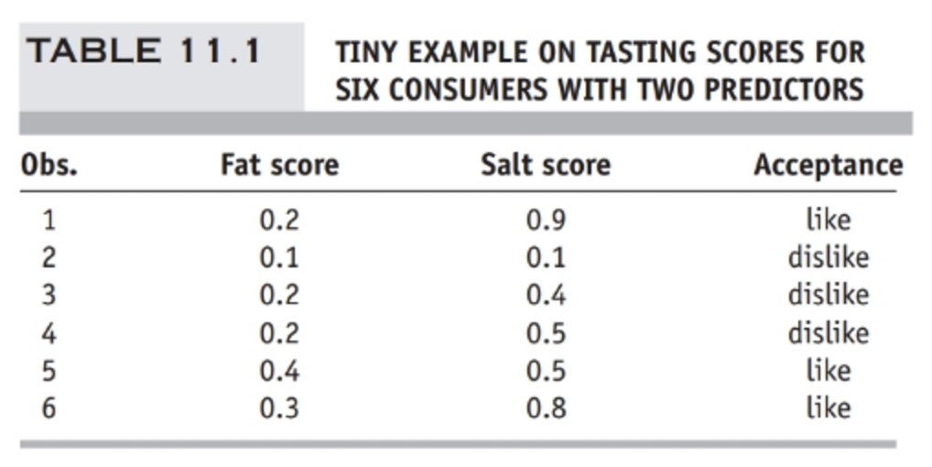
Example
Looking at this example, what is the size of the input layer?
What is the size of the output layer?

Slide 24
Python
Notes:
Guidelines
Use a title slide at the beginning of your presentation. There are 9 variations of title slides to choose from.
If you will have a series of slideshows, we recommend using the same style of title slide for each presentation.
Keep your title to no more than 2 lines.
Do not change the font style or font size of the title or subtitle.

Slide 25
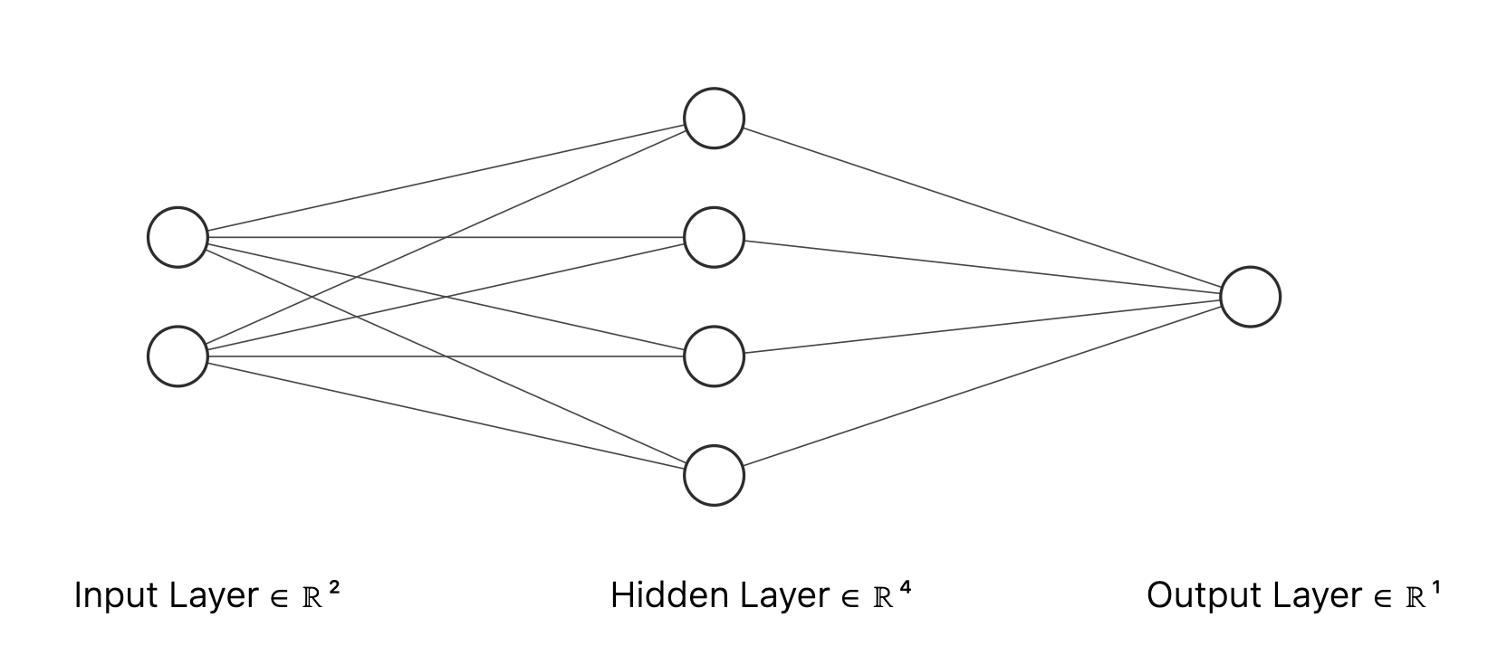
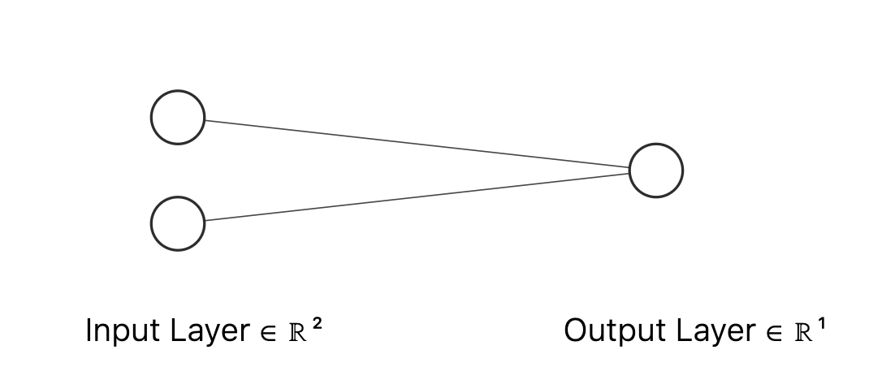
hidden_layer_sizes

Slide 26
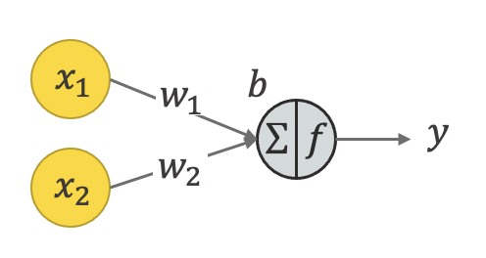
Neurons (units)
In each neuron we have inputs and outputs
Inputs come from previous neurons
Outputs are the results of inner calculations within the neurons

Slide 27

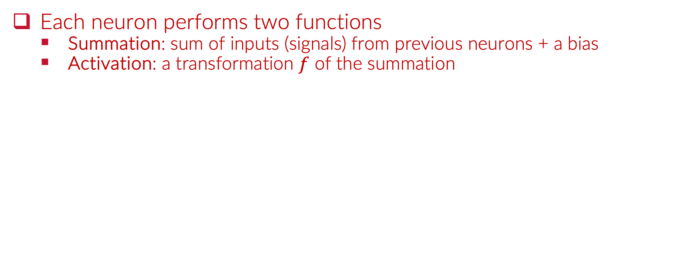
Neurons Calculations ($∑$ and $f$)
Each neuron performs two functions
Summation: sum of inputs (signals) from previous neurons + a bias
Activation: a transformation $f$ of the summation

Slide 28
Python
Notes:
Guidelines
Use a title slide at the beginning of your presentation. There are 9 variations of title slides to choose from.
If you will have a series of slideshows, we recommend using the same style of title slide for each presentation.
Keep your title to no more than 2 lines.
Do not change the font style or font size of the title or subtitle.

Slide 29
Example

Slide 30
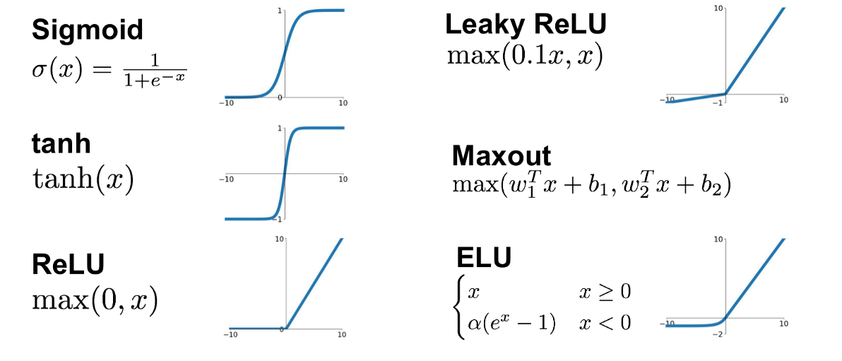

The Activation Function $f$
Transforms the sum of the signals to amplify or inhibit them

Slide 31
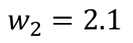
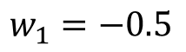
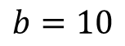
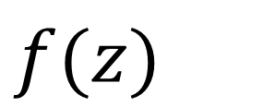
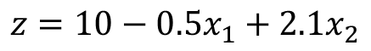
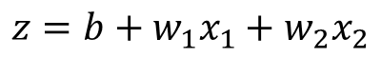
The Activation Function $f$
Transforms the sum of the signals to amplify or inhibit them
$$z=b+w_{1}x_{1}+w_{2}x_{2}$$
$$f(z)$$
$$b=10$$
$$w_{1}=−0.5$$
$$z=10−0.5x_{1}+2.1x_{2}$$
$$w_{2}=2.1$$

Slide 32
The Activation Function $f$
Transforms the sum of the signals to amplify or inhibit them
$$z=b+w_{1}x_{1}+w_{2}x_{2}$$
$$f(z)$$
$$b=10$$
$$w_{1}=−0.5$$
$$z=10−0.5x_{1}+2.1x_{2}$$
$$w_{2}=2.1$$

Slide 33
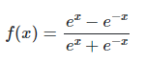
The Activation Function $f$
Transforms the sum of the signals to amplify or inhibit them
$$z=b+w_{1}x_{1}+w_{2}x_{2}$$
$$f(z)$$
$$b=10$$
$$w_{1}=−0.5$$
$$z=10−0.5x_{1}+2.1x_{2}$$
$$w_{2}=2.1$$

Slide 34
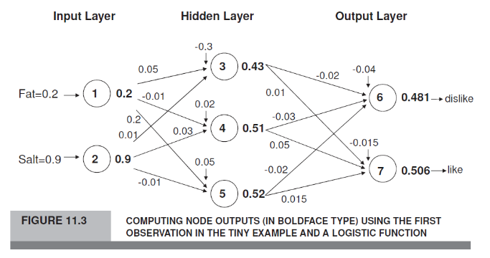
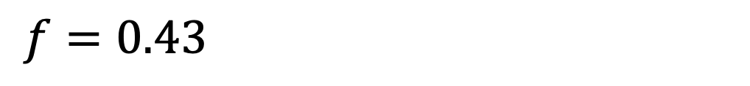
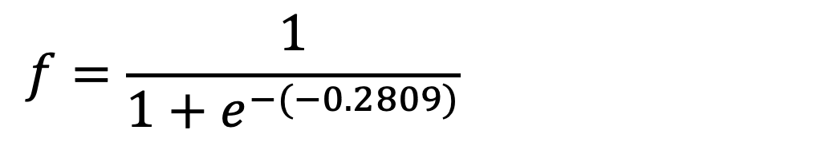
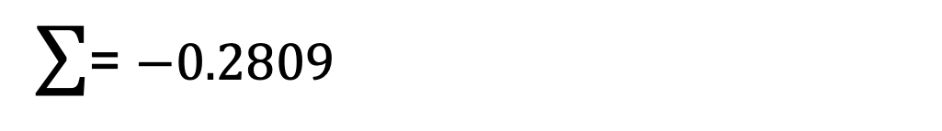
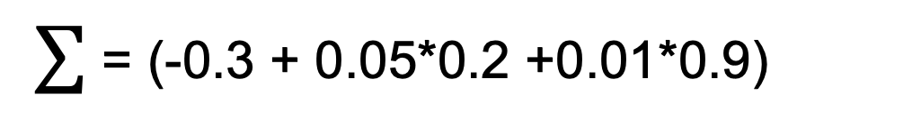
Neurons Calculations ($∑$ and $f$)
Example:
$∑$ = (-0.3 + 0.05*0.2 +0.01*0.9)
$∑$= $−0.2809$
$$f=\frac{1}{1+e^{−(−0.2809)}}$$
$$f=0.43$$

Slide 35
Hyperparameter
Activation function: relu, logistic, tanh, identity

Slide 36
Python
Notes:
Guidelines
Use a title slide at the beginning of your presentation. There are 9 variations of title slides to choose from.
If you will have a series of slideshows, we recommend using the same style of title slide for each presentation.
Keep your title to no more than 2 lines.
Do not change the font style or font size of the title or subtitle.

Slide 37
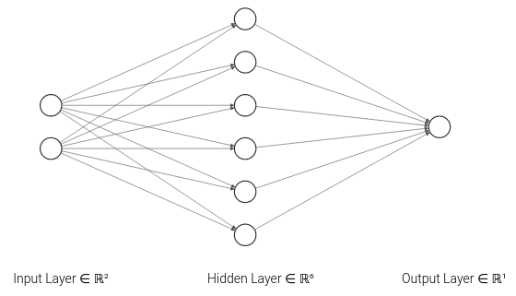
Calculating the number of parameters
Number of parameters included weights and biases
It depends on the number of neurons and layers
Number of weights = units (input layer) * units (hidden 1) + (units hidden 1* units output)
Number of weights = 2*6 + 6*1 = 18 weights

Slide 38
Calculating the number of parameters
Number of parameters included weights and biases
It depends on the number of neurons and layers
Number of biases = units (hidden 1) + units output
Number of biases = 6 + 1 = 7 biases

Slide 39
Calculating the number of parameters
Number of parameters included weights and biases
It depends on the number of neurons and layers
Total Number of Parameters = Number of Weights + Number of Biases
Total Number of Parameters = 25

Slide 40
Calculating the number of parameters
The more parameters estimated, the more data needed
Overfitting happens when too few obs estimate many parameters
Total Number of Parameters = (2*3 + 3*2) + 3 + 2
Total Number of Parameters = 17

Slide 41
Python
Notes:
Guidelines
Use a title slide at the beginning of your presentation. There are 9 variations of title slides to choose from.
If you will have a series of slideshows, we recommend using the same style of title slide for each presentation.
Keep your title to no more than 2 lines.
Do not change the font style or font size of the title or subtitle.

Slide 42
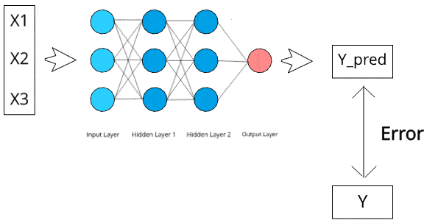
Backpropagation
The process of updating the parameters at each iteration
Backpropagation uses gradient descent to estimate update given
Source: https://medium.com/deep-learning-demystified/introduction-to-neural-networks-part-2-c261a99f4138

Slide 43
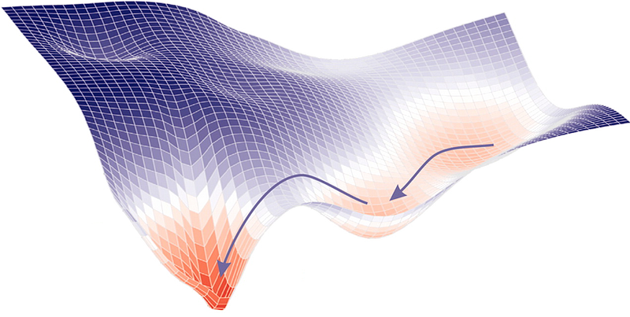
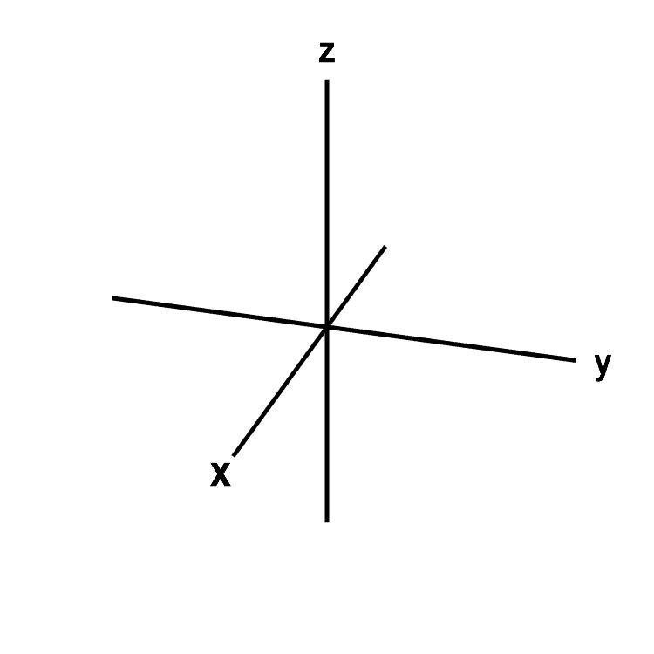
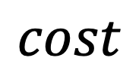
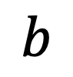
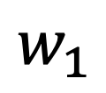
Backpropagation
The process of updating the parameters at each iteration
Backpropagation uses gradient descent
$$cost$$
$$w_{1}$$
$$b$$

Slide 44
Important Hyperparameters
Maximum steps: max_iter
Step size: learning_rate, learning_rate_init
$$cost$$
$$w_{1}$$
$$b$$

